Slide 1

Flight Reservation System
Group Members
Muhammad Rasib
Ateeq Rehman

Slide 2

Table of Content
Introduction
Features
Pictures of Frames
Future Work

Slide 3
Introduction Simplified Booking Process Seat Selection Updating flight booking

Slide 4
Features
Sign In / Sign Out
Booking Seats
Updating Flight Booking
Cancellation of Booking

Slide 5
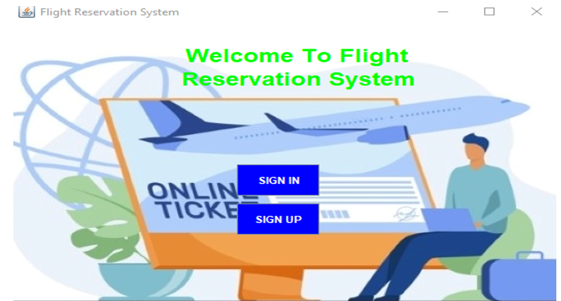
Welcome Screen

Slide 6
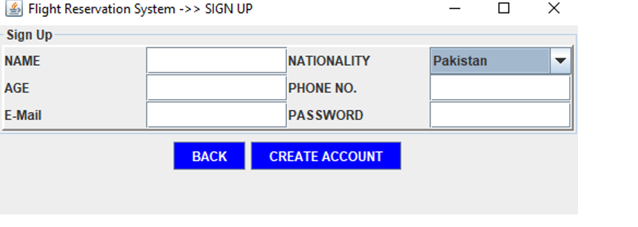
Creating Account

Slide 7
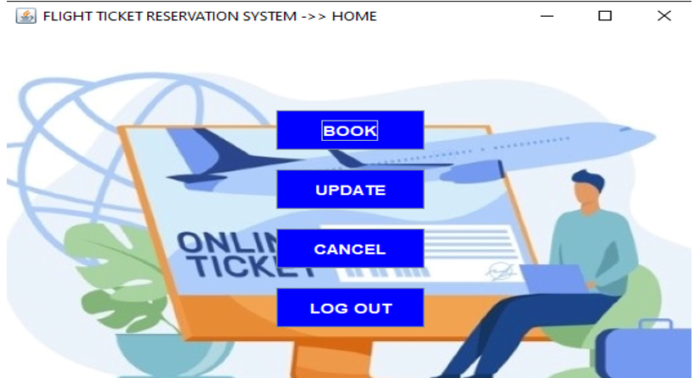
Main Window

Slide 8
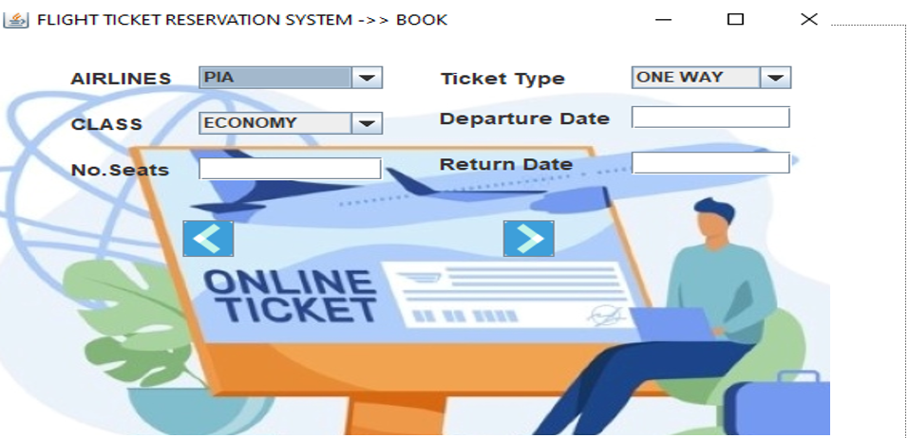
Seat Booking

Slide 9
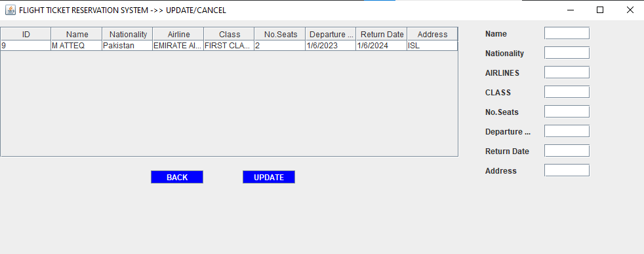
Updating Flight Booking

Slide 10
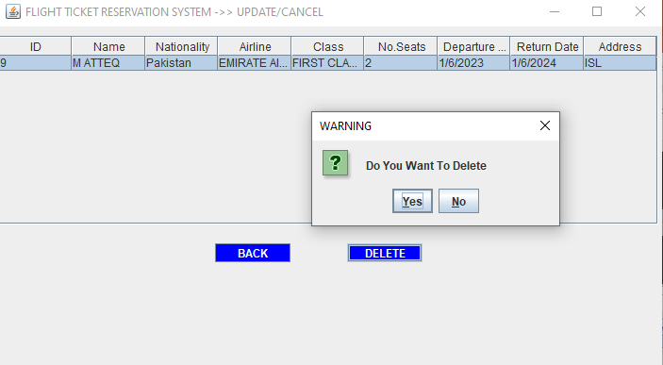
Cancellation Booking

Slide 11
Future Work
Show Schedule of Flights
Show Seats Left
Show Bill
AI

